Slide 1
MQTT & CoAP

Slide 2
Background
Polling Model:
Applications send queries to sensor nodes to retrieve information.
Problem?
When an event of interest occurs, in order to react in real-time, the sensor nodes have to be queried continuously.
Waste of resources such as energy, processing and bandwidth.

Slide 3
Background
Publish/Subscribe Model
Entities:
Publisher: generate events
Subscriber: express interest in events
Subscription:
Register interest in the event
Advantages:
Decouple in time: publishers and scubscribers do not need to be actively participating in the interaction at the same time
Decouple in space: publishers and subscribers do not need to know each other
Publishers and subscribers can produce or consume events in an asynchronous way.

Slide 4
Publication Discipline
Activation: when there is a pending confirmation of a publication message, and a new publication is generated
MQTT-S publication discipline:
Discard the new publication message
CoAP publication discipline:
Discard the old publication message
An inappropriate fixed RTO will result in a higher probability of a new publication message being generated while the RTO is active. Therefore, the publication discipline will discard the publication message (Old or New).

Slide 5
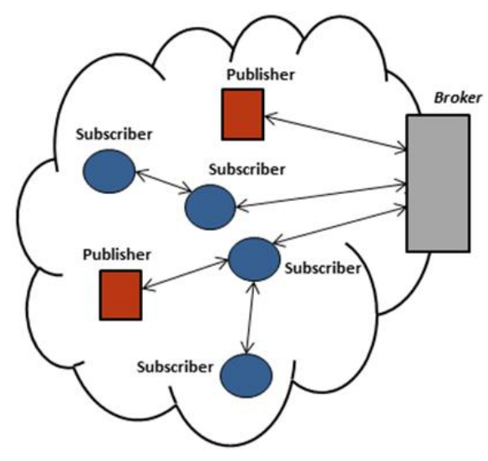
MQTT-S
Extension of the Message Queuing Telemetry Transport (MQTT) Optimized for WSN.
Components:
Broker node:
responsible for managing subscriptions as well as storing and sending publications to corresponding WSN subscriber nodes.
Publisher nodes:
generate event
Subscriber nodes:
express interest in events
Relay nodes:
for multi-hop scenario.

Slide 6
MQTT-S
Reliability:
QoS Level 0 (QoS0)
Offers a best-effort delivery service, no retransmission or Acknowledgements.
QoS Level 1 (QoS1)
Allows the retransmission of messages until Acked
Does not prevent duplicate reception
QoS Level 2 (QoS2)
Ensures the reception of message
Ensures to deliver only once to the destination by four message handshake.
Parameters for QoS1 and QoS2:
Fixed RTO: 10-15 seconds.
Retransmission number: 3-5

Slide 7
MQTT-S
Publication Discipline:
“stop and wait” mechanism for the transmissions of publication messages with QoS1 and QoS2.
A publisher node has to wait for the termination of its publication message flow with the broker node before it can start a new one.
If more than one publications are generated, publication discipline is needed.
Activity 1: Queue the new publication messages
Drawback: cost more source
Activity 2: Drop the new publication messages
Always attempts to retransmit the old publication message till receive the ACK.
Called ‘Persistent mode’ discipline

Slide 8
CoAP
Characteristics:
RESTful (Representational State Transfer)
Resources are identified by Universal Resource Identifiers (URI)
UDP based
Model:
Client/server interaction model
Request messages initiate a transaction with a server, which may send a response to the client with a matching transaction ID
Polling based: not suitable for requiring information in real-time in order to react when an event of interest occurs.
Publish/subscribe interaction model
A.k.a: Observer Model
A publisher node can send publications to a subscriber node (observer) about a event that the subscriber is interested in receiving .

Slide 9
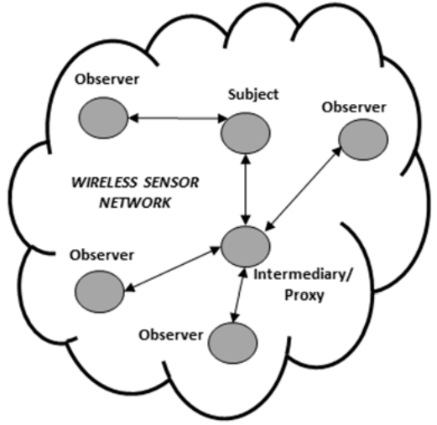
CoAP
Publish/subscribe interaction model
A subscriber constantly to observe the events by registering its interest in the event (GET request to the publisher node).
Subscription Action:
Publisher node establishes an observation relationship between the subscriber and the event.
The publisher notifies each subscriber node that has an observation relationship with the event.
Observer Model:
High scalability
Use caches and proxy nodes that multiplex the interest of multiple subscribers in the same event into a single association

Slide 10
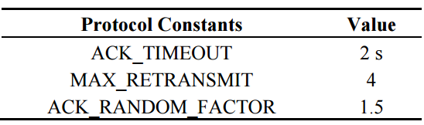
CoAP
Reliability:
Non-Confirmable (NON) message:
Correspond to MQTT-S QoS 0
No ACK to messages
Confirmable (CON) message:
Correspond to MQTT-S QoS 1
ACK messages received
Fixed RTO
Random number between and ACK TIMEOUT constant and an ACK TIMEOUT multiplied by ACK-RANDOM-FACTOR
UnACKed messages within RTO are retransmitted
RTO is doubled (Exponential back-off mechanism)
MAX_RETRANSMIT: Maximum retransmission numbers

Slide 11
CoAP
Publication Discipline:
“stop and wait” mechanism for the transmission of CON messages. Same with MQTT-S.
Publication discipline is also needed to handle publication messages generated while the publication message flow is in progress (RTO is active)
Activity:
Stop the retransmission of old publication message
Transmit the new publication message with the number of attempts remaining from the old publication message.

Slide 12
MQTT-S and CoAP
Fixed RTO:
Too short: give rise to spurious retransmissions, waste bandwidth, energy and computation.
Too long: lead to slow or late reaction to the loss of packets, increase delay ,decrease PDR.
Suitable for deployments when RTT is close to the defined RTO value.
Not suitable for scalability and flexibility features by the publish/subscribe model on WSN.
Adaptive RTO:
Compute smoothed RTT (SRTT)
SRTT = (1 - a) x SRTT + a x RTT
Compute RTO
RTO = SRTT x K

